Slide 1
Predicting Goodreads Review Popularity
FINAL PROJECT REVIEW
Combining text embeddings and reviewer features to explain what makes a review popular
Team Project · Course Name
Notes:
Hook: Goodreads sorts reviews by engagement, so popular reviews get more visibility, which snowballs into even more likes/comments. Reviewers with strong presence also get free advance copies of books. So there's a real incentive to understand what makes a review popular. That's what this project predicts and explains.

Slide 2
Problem statement
Some book reviews get far more reader engagement than others. Can we predict which reviews will be popular — and understand why — using the review's text and the reviewer's activity history?
Why it matters
Our question
Surfacing high-engagement reviews earlier helps readers, authors, and the platform.
Do semantic embeddings plus simple engineered features beat either alone?
2 / 8
Notes:
"Popular" here = a review's likes+comments relative to other reviews on the same book, thresholded at ~21% prevalence. We're the first to study this for book reviews specifically — prior popularity research was on product reviews, which motivate purchases, not readership, so the drivers could be totally different. Our core question: do semantic embeddings plus simple reviewer/text metadata beat either alone?

Slide 3
Dataset
200,000
54,434
28,414
Goodreads reviews
Training reviews (balanced)
Held-out test reviews
Non-text features
Text-stat features
Reviewer's review count · days since posted · star rating · rating vs. book average
Word count · sentence/word length · quotes · punctuation counts · sentiment
Split 70 / 15 / 15, grouped by book_id to prevent leakage across splits
3 / 8
Notes:
Split by book_id, not randomly by review, so the same book never leaks across train/val/test. Training set was undersampled to 50/50 popular/unpopular — real-world rate is ~79/21 — so the model can actually learn the minority class. Validation and test stay at the natural imbalanced rate so our reported metrics are honest, not inflated by an artificial balance.

Slide 4
Approach
Three feature representations, two model families — to isolate what text understanding adds over simple metadata.
Feature set | Models tried | Role
TF-IDF (5,000 terms) | Logistic Regression | Classical text baseline
MiniLM embeddings (384-d) | LogReg, XGBoost | Semantic text baseline
Engineered features + MiniLM | LogReg, XGBoost | Does metadata add signal?
Best model explained with SHAP (TreeExplainer); embeddings grouped into one block for interpretability
4 / 8
Notes:
Three representations, deliberately layered: TF-IDF is the classical sparse baseline (literal word counts, 5,000 terms). MiniLM embeddings alone swap that for dense 384-d semantic vectors — meaning, not word identity. The third row adds engineered reviewer/text metadata on top of embeddings, to answer: does metadata still help once you already have semantics? Two model families (LogReg, XGBoost) per representation where relevant.

Slide 5
Results
Features | Model | Accuracy | F1 | ROC-AUC | PR-AUC
TF-IDF | LogReg | 0.642 | 0.430 | 0.694 | 0.370
MiniLM embeddings | LogReg | 0.593 | 0.396 | 0.651 | 0.311
MiniLM embeddings | XGBoost | 0.585 | 0.403 | 0.655 | 0.315
Engineered + MiniLM | LogReg | 0.646 | 0.426 | 0.687 | 0.351
Engineered + MiniLM | XGBoost | 0.657 | 0.457 | 0.733 | 0.417
Combined features + XGBoost wins on every metric. TF-IDF alone stays competitive with embeddings alone — simple word frequency holds its own at this scale.
5 / 8
Notes:
Read bottom row first — that's the winner: XGBoost on engineered + MiniLM, ROC-AUC 0.733, best on every metric. Notice TF-IDF alone (0.694) almost matches MiniLM alone (0.651-0.655) — simple word frequency is a surprisingly strong baseline at this scale. The real gain comes from combining semantics with metadata, not from embeddings replacing TF-IDF outright.

Slide 6
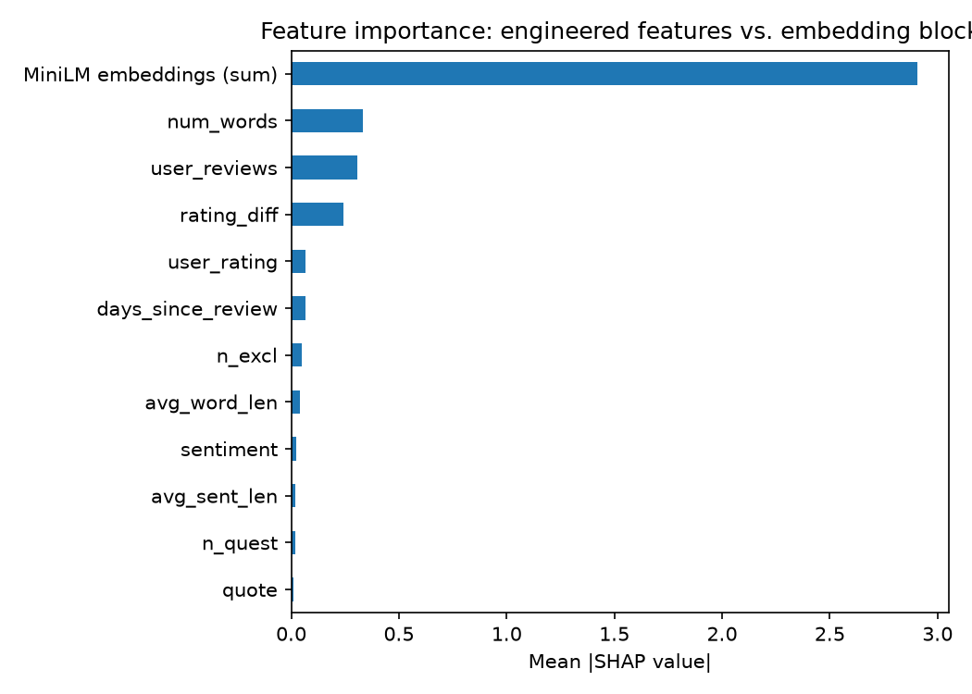
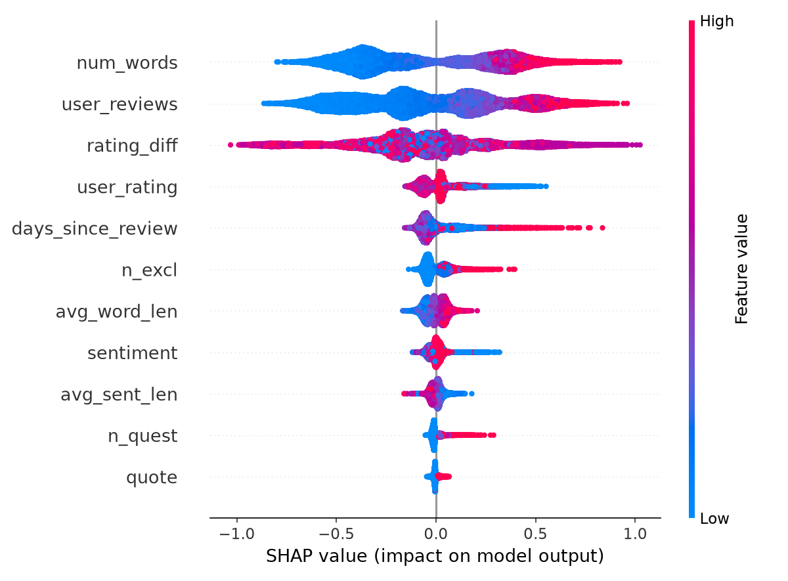
Prediction results :

Slide 7




What drives the prediction?
Mean |SHAP value| on the test set, best model (XGBoost, Engineered + MiniLM)
MiniLM embeddings (sum)
2.91
num_words
0.33
user_reviews
0.31
rating_diff
0.24
other 7 features combined
0.27
Embeddings dominate overall, but review length and reviewer activity are the strongest single engineered signals.
Surprise: lower star ratings show a mild positive link to popularity — critical reviews may draw more engagement.
6 / 8
Notes:
Embeddings dominate as a block, which makes sense — 384 dimensions vs. 11 engineered features. Among the engineered features, review length and reviewer activity (user_reviews) are the strongest single signals, meaning longer reviews from experienced reviewers do better. The surprising finding: lower star ratings have a mild positive link to popularity — critical reviews may stand out and draw more engagement than another positive review blending into the crowd.

Slide 8
How this compares to prior work
Daly (Stanford, 2021), "Text-Based Prediction of Book Review Popularity" — same Goodreads dataset family, same popularity definition (~21% prevalence), same core reviewer/text features.
 | Daly (2021) | This project
Text representation | Bag-of-Words / TF-IDF (10,000+ sparse dims) | MiniLM sentence embeddings (384 dense dims)
What the text features capture | Word identity and frequency | Semantic meaning of the review
Models tried | Logistic Regression, XGBoost, Neural Net | Logistic Regression, XGBoost
Best ROC-AUC | 0.70 | 0.733
Explainability | Tree-split counts and SHAP, static plots | SHAP, plus a live interactive demo
What carries over
What's new here
Reviewer activity (user_reviews) dominates engineered signal in both studies, and critical/negative reviews show the same mild positive link to popularity.
Swapping sparse word counts for dense semantic embeddings improves ROC-AUC with a far smaller feature space — and the model is shown live, not just reported.
7 / 8
Notes:
Daly (Stanford, 2021) is the closest prior work — same dataset family, same popularity definition, so this is a fair apples-to-apples comparison. Her best result used sparse Bag-of-Words/TF-IDF; we swap that for dense MiniLM embeddings and beat her best ROC-AUC (0.733 vs 0.70) with a much smaller feature space. Two findings replicate independently across both studies: reviewer activity dominates engineered signal, and critical reviews get a popularity boost. What's new here: the smaller semantic representation, and a live demo instead of just a static report.

Slide 9
Conclusions
Combining signals wins
Moderate, honest signal
Explainable & interactive
Embeddings + engineered metadata, scored with XGBoost, beat every single-feature-set baseline — and the prior paper's own best result.
ROC-AUC 0.73 — real predictive power, but popularity clearly depends on more than text and basic metadata.
SHAP grounds the model's behavior; a live Streamlit demo makes it tangible.
Live demo →
8 / 8
Notes:
Bottom line: combining semantic embeddings with simple metadata, scored with XGBoost, gives real but moderate predictive power. ROC-AUC 0.73 means popularity depends on more than text and basic metadata — likely reviewer follower counts, which neither this dataset nor Daly's had access to. Transition to demo: paste in a review live, show the predicted probability and SHAP breakdown updating in real time.

